Slide 1




Bhoomika S Vempathi

Slide 2




Project title :
HR Department

Slide 3

What is SQL? Why it is used?
Structured Query Language is a computer language that we used to interact with a relational database. SQL is a tool for organizing, managing and retrieving achieved data from the database.
SQL is used to communicate with a database.
SQL lets us to access and manipulate databases.

Slide 4



Query
A Query in SQL is a request for Data or Information from a Database table or Combination of tables.

Slide 5

What is Human Resource ?
Human Resources (HR) focuses on managing an organization’s most valuable asset:
its employees.
HR professionals ensure employees have the necessary resources for their tasks and foster a positive work environment. They handle various responsibilities, from recruiting and compliance to benefits and training.

Slide 6


How is SQL used in HR Department ?
Using SQL in HR helps systematize data about employees. With relational databases, finding information about an employee from a specific department is no longer a problem. It’s also much easier to generate reports and summary statistics on wages, holidays, productivity, and turnover.

Slide 7

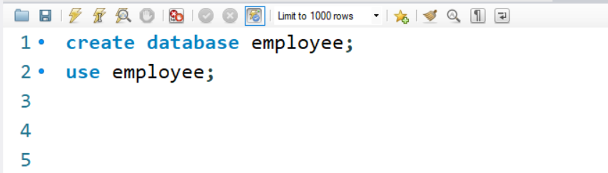
What is Database ?
A database is an organized collection of structured information, or data, typically stored electronically in a computer system. A database is usually controlled by a Database Management System (DBMS).
SYNTAX: CREATE DATABASE database_name;

Slide 8
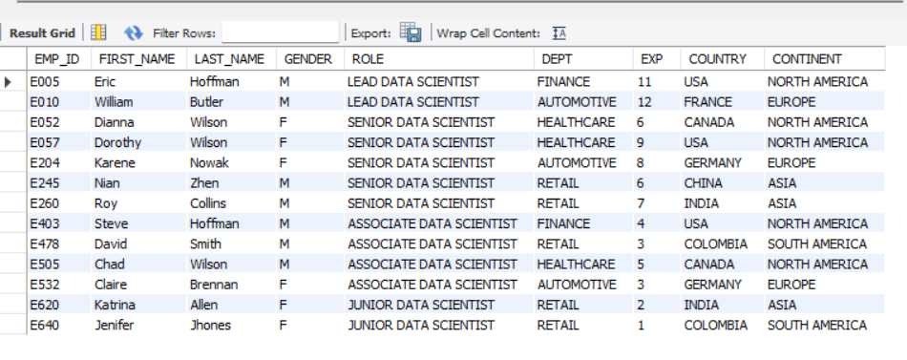

Importing Data of data_science_team
Select * from data_science_team;

Slide 9
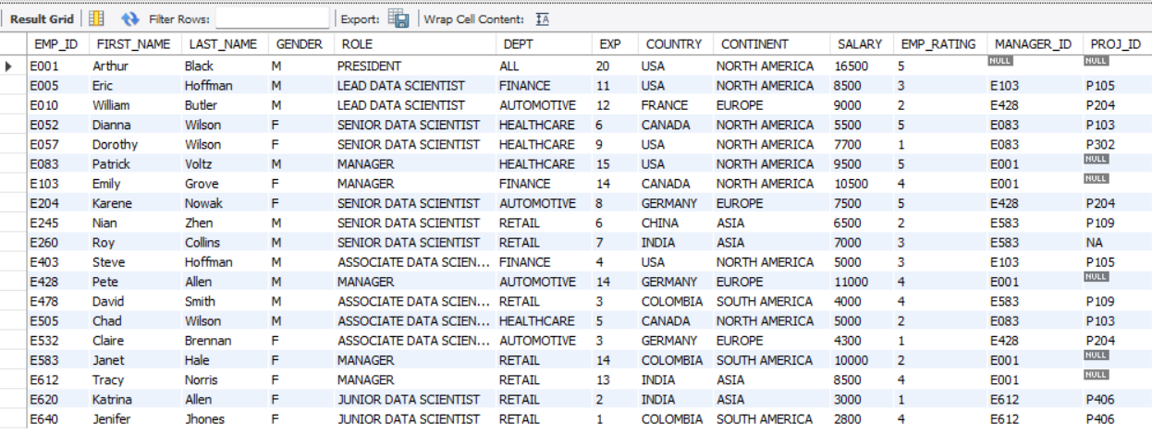

Importing the Data of Emp_record_table
Select * from emp_record_table;

Slide 10
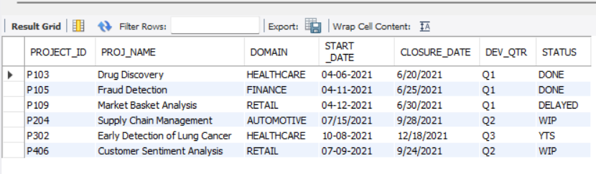

Importing data of Proj_table
Select * from proj_table;

Slide 11
Entity Relation (ER) Diagram
Entity-Relationship (ER) model is a visual representation of the table’s structure and the relationships between logically related tables.
In ER modeling the database structure is represented as a diagram known as ER diagram (ERD). An ER diagram gives a better understanding of the overall database structure. It becomes easier to map the tables, their keys, and relationships.
The ER diagram displays:
Table structure along with the column names and their data types
Primary and foreign key constraints
Relationship between table

Slide 12
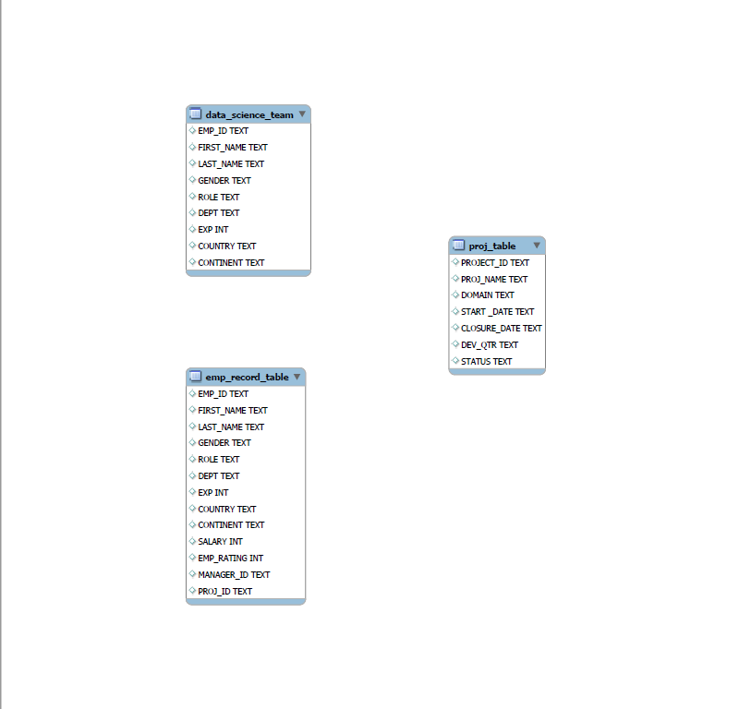

ER diagram for the employee database.

Slide 13
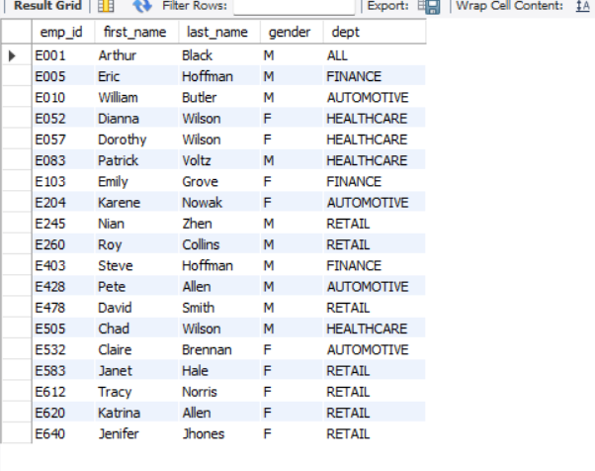

Query to fetch EMP_ID, FIRST_NAME, LAST_NAME, GENDER, and DEPARTMENT from the employee record table, and make a list of employees and details of their department
Select emp_id,first_name,last_name,gender,dept from emp_record_table;

Slide 14


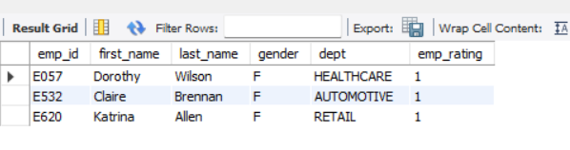
Query to fetch EMP_ID, FIRST_NAME, LAST_NAME, GENDER, DEPARTMENT, and EMP_RATING if the EMP_RATING is:
1. less than two
Select emp-id, first_name, last_name, gender, dept, emp-rating
From emp_record_table
WHERE emp_rating >2;

Slide 15
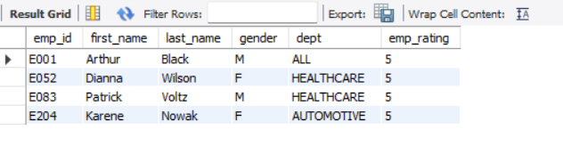


Query to fetch EMP_ID, FIRST_NAME, LAST_NAME, GENDER, DEPARTMENT, and EMP_RATING if the EMP_RATING is:
2. greater than four
Select emp-id, first_name, last_name, gender, dept, emp-rating
From emp_record_table
WHERE emp_rating >4;

Slide 16

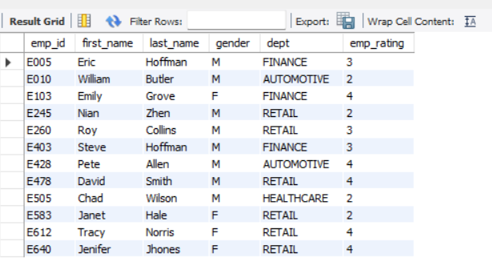
Query to fetch EMP_ID, FIRST_NAME, LAST_NAME, GENDER, DEPARTMENT, and EMP_RATING if the EMP_RATING is:
3. Between 2 and 4
select emp_id, first_name, last_name, gender, dept, emp_rating
from emp_record_table
WHERE emp_rating between 2 and 4;

Slide 17

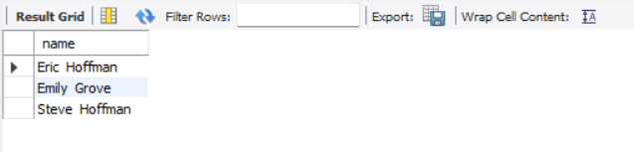
query to concatenate the FIRST_NAME and the LAST_NAME of employees in the Finance department from the employee table and then give the resultant column alias as NAME.
Select CONCAT (first_name,' ',last_name)AS name
from emp_record_table where dept='finance';

Slide 18
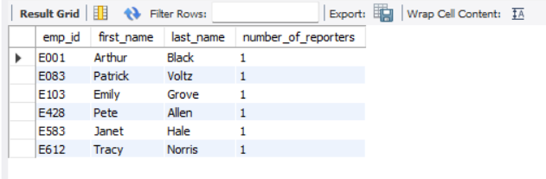

Query to list only those employees who have someone reporting to them. Also, show the number of reporters (including the President).
Select emp_id,first_name,last_name,
COUNT(*) AS number_of_reporters
from emp_record_table
WHERE emp_id IN(select distinct manager_id
from emp_record_table)
group by emp_id,first_name,last_name;

Slide 19


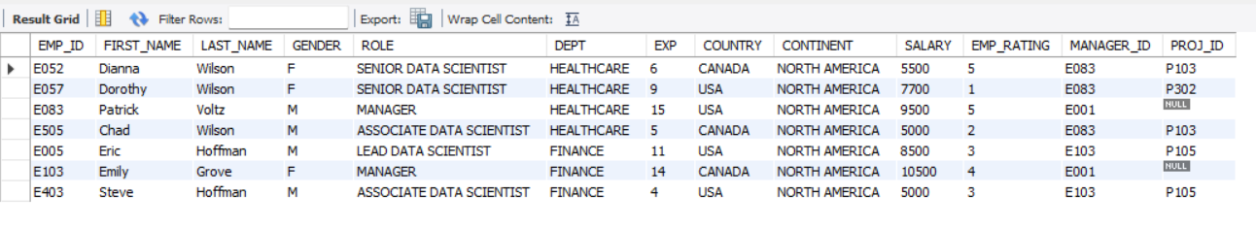
Query to list down all the employees from the healthcare and finance departments using union.
Take data from the employee record table.
Select * from emp_record_table
WHERE dept = 'Healthcare’
UNION
Select* from emp_record_table
WHERE dept = 'Finance';

Slide 20
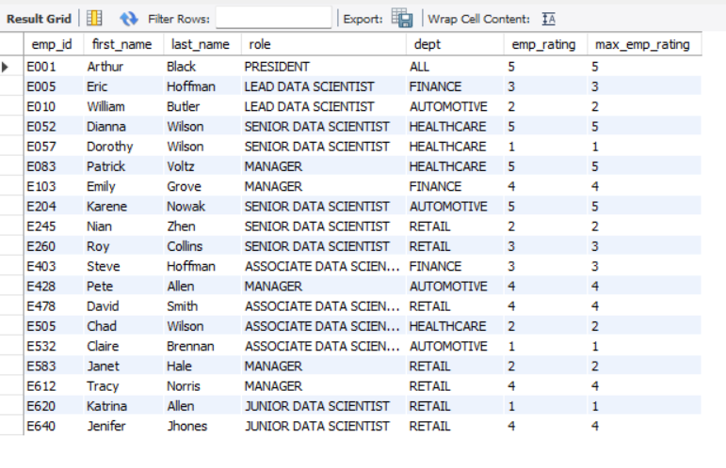

Query to list down employee details such as emp_id, first_name, last_name, role, department and emp_rating grouped by dept. Also include the respective employee rating along with the max emp rating for the department.
Select emp_id, first_name, last_name, role, dept,emp_rating,
MAX(emp_rating)
AS max_emp_rating
From emp_record_table
GROUP BY dept,emp_id,first_name,last_name,role,emp_rating;

Slide 21
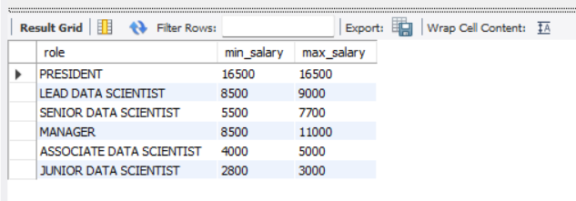

Query to calculate the minimum and the maximum salary of the employees in each role, from the employee record table.
Select role,
min(salary)AS min_salary,
max(salary)AS max_salary
from emp_record_table
GROUP BY role;

Slide 22
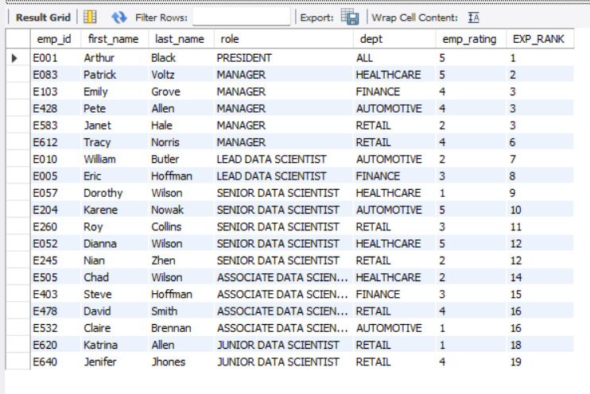

Query to assign ranks to each employee based on their experience, from the employee record table.
Select emp_id,first_name,
last_name,role,dept,emp_rating,
RANK() OVER (ORDER BY EXP DESC) AS EXP_RANK
From emp_record_table;

Slide 23
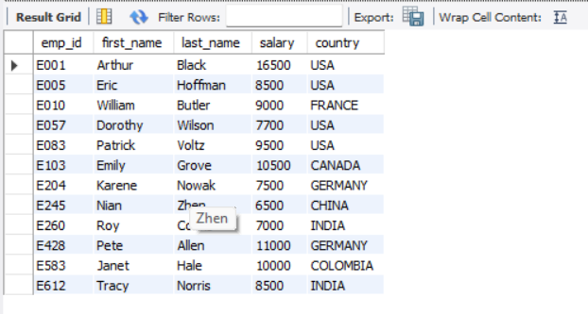

Query to create a view that displays employees in various countries whose salary is more than six thousand, from the employee record table.
Create view emp_view AS
Select emp_id,first_name,
last_name, salary, country
from emp_record_table
WHERE SALARY >6000;
Select * from emp_view;

Slide 24
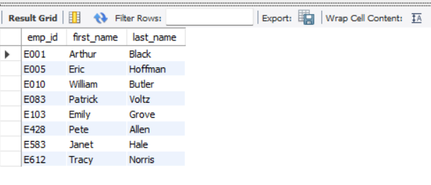

Nested query to find employees with experience of more than ten years, from the employee record table.
Select emp_id,
first_name, last_name
FROM emp_record_table
WHERE EXP > 10;

Slide 25

STORED PROCEDURE
A stored procedure is a prepared SQL code that you can save, so the code can be reused over and over again,
So if you have an SQL query that you write over and over again, save it as a stored procedure, and then just call it to execute it.
You can also pass parameters to a stored procedure, so that the stored procedure can act based on the parameter value(s) that is passed.

Slide 26
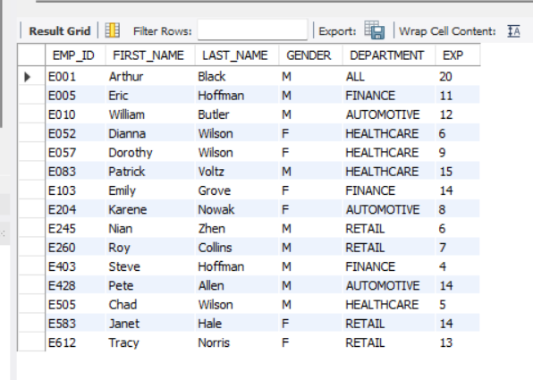
Query to create a stored procedure to retrieve the details of the employees whose experience is more than three years, from the employee record table.
.
CALL GetEmployeesWithExperience;
CREATE DEFINER=`root`@`localhost` PROCEDURE `GetEmployeesWithExperience`()
BEGIN
Select EMP_ID,FIRST_NAME,LAST_NAME,
GENDER,DEPT AS DEPARTMENT, EXP
FROM emp_record_table
WHERE EXP>3;
END

Slide 27
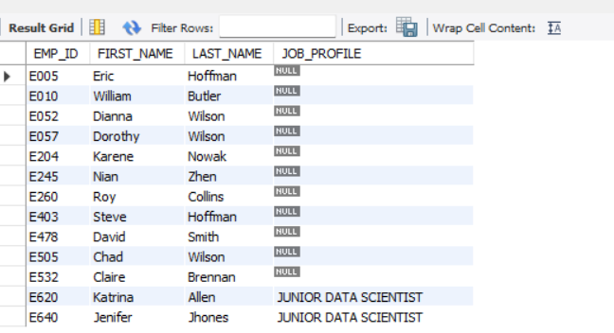

Write a query using stored functions in the project table to check whether the job profile assigned to each employee in the data science team matches the organization’s set standard. The standard being:
1. For an employee with experience less than or equal to 2 years assign 'JUNIOR DATA SCIENTIST',
CREATE DEFINER=`root`@`localhost` FUNCTION `GetJobProfile`(experience INT)
RETURNS varchar(60) CHARSET utf8mb4 DETERMINISTIC
BEGIN
DECLARE job_profile
VARCHAR(60);
IF experience <=2
THEN SET job_profile ='JUNIOR DATA SCIENCE’;
END IF;
RETURN job_profile;
END
SELECT EMP_ID,FIRST_NAME,LAST_NAME,
GetJobProfile(EXP)
AS JOB_PROFILE
FROM data_science_team;

Slide 28
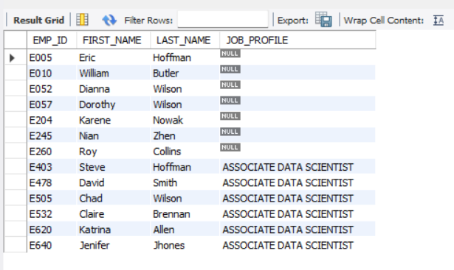

2. For an employee with the experience of 2 to 5 years assign 'ASSOCIATE DATA SCIENTIST',
CREATE DEFINER=`root`@`localhost` FUNCTION `GetJobProfile`(experience INT)
RETURNS varchar(60)
CHARSET utf8mb4
DETERMINISTIC
BEGIN
DECLARE job_profile
VARCHAR(60);
IF experience <=5
THEN SET job_profile =‘ASSOCIATE DATA SCIENTIST’;
END IF;
RETURN job_profile;
END
SELECT EMP_ID,FIRST_NAME,LAST_NAME,
GetJobProfile(EXP)
AS JOB_PROFILE
FROM data_science_team;

Slide 29
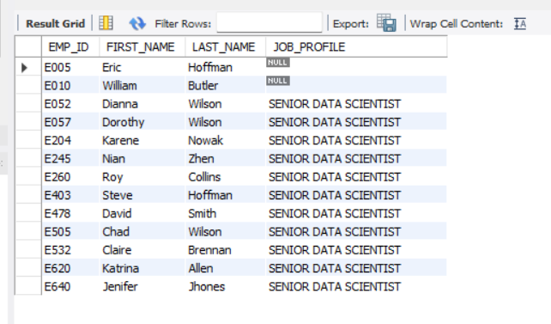
3. For an employee with the experience of 5 to 10 years assign 'SENIOR DATA SCIENTIST',
CREATE DEFINER=`root`@`localhost` FUNCTION `GetJobProfile`(experience INT)
RETURNS varchar(60)
CHARSET utf8mb4
DETERMINISTIC
BEGIN
DECLARE job_profile
VARCHAR(60);
IF experience <=10
THEN SET job_profile =‘SENIOR DATA SCIENTIST’;
END IF;
RETURN job_profile;
END
SELECT EMP_ID,FIRST_NAME,LAST_NAME,
GetJobProfile(EXP)
AS JOB_PROFILE
FROM data_science_team;

Slide 30
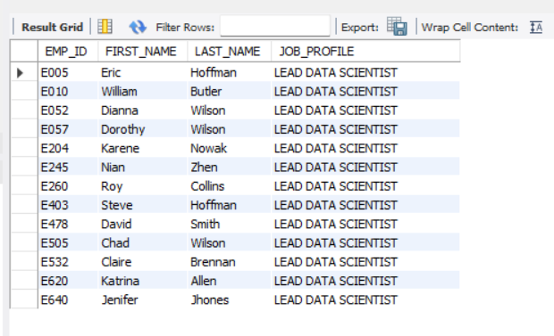

4. For an employee with the experience of 10 to 12 years assign 'LEAD DATA SCIENTIST',
CREATE DEFINER=`root`@`localhost` FUNCTION `GetJobProfile`(experience INT)
RETURNS varchar(60)
CHARSET utf8mb4
DETERMINISTIC
BEGIN
DECLARE job_profile
VARCHAR(60);
IF experience <=12
THEN SET job_profile =‘LEAD DATA SCIENTIST’;
END IF;
RETURN job_profile;
END
SELECT EMP_ID,FIRST_NAME,LAST_NAME,
GetJobProfile(EXP)
AS JOB_PROFILE
FROM data_science_team;

Slide 31
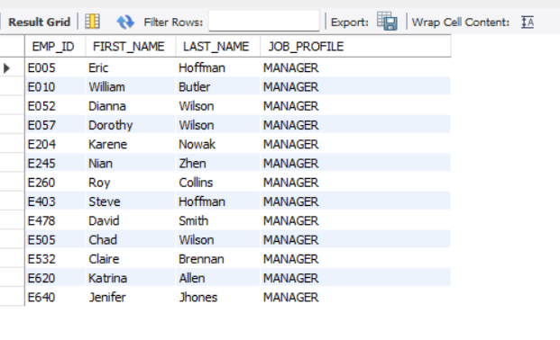

5. For an employee with the experience of 12 to 16 years assign 'MANAGER'.
CREATE DEFINER=`root`@`localhost` FUNCTION `GetJobProfile`(experience INT)
RETURNS varchar(60)
CHARSET utf8mb4
DETERMINISTIC
BEGIN
DECLARE job_profile
VARCHAR(60);
IF experience <=16
THEN SET job_profile =‘MANAGER
END IF;
RETURN job_profile;
END
SELECT EMP_ID,FIRST_NAME,LAST_NAME,
GetJobProfile(EXP)
AS JOB_PROFILE
FROM data_science_team;

Slide 32
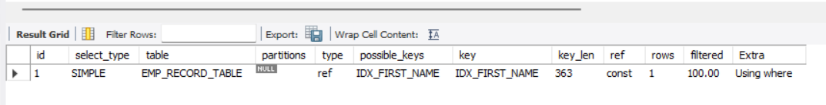
Create an index to improve the cost and performance of the query to find the employee whose FIRST_NAME is ‘Eric’ in the employee table after checking the execution plan.
CREATE INDEX IDX_FIRST_NAME
ON EMP_RECORD_TABLE
(FIRST_NAME(225));
EXPLAIN SELECT * FROM EMP_RECORD_TABLE
WHERE FIRST_NAME = "ERIC";

Slide 33
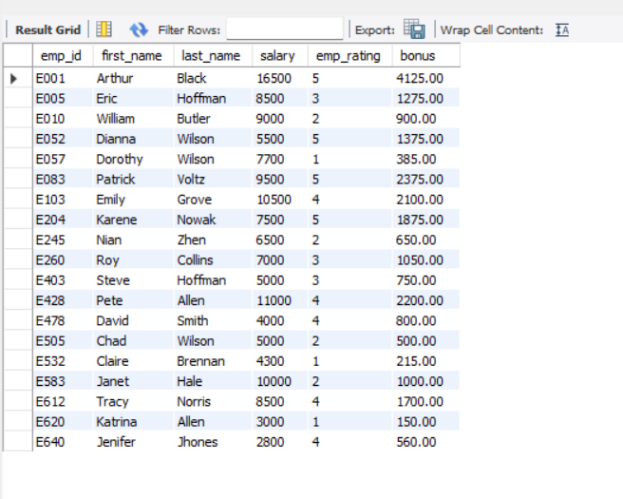
Write a query to calculate the bonus for all the employees, based on their ratings and salaries
(Use the formula: 5% of salary * employee rating).
Select emp_id,first_name,
last_name,salary,
emp_rating,
(0.05*salary*emp_rating)
as bonus
from emp_record_table;

Slide 34
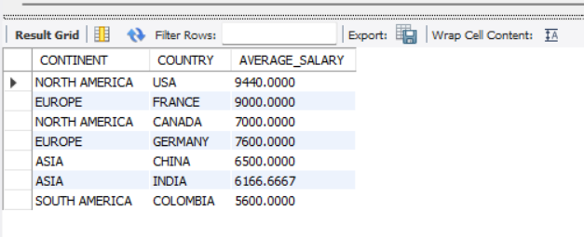
Write a query to calculate the average salary distribution based on the continent and country. Take data from the employee record table.
SELECT CONTINENT, COUNTRY,
AVG(SALARY) AS AVERAGE_SALARY
FROM emp_record_table
GROUP BY CONTINENT,COUNTRY;

Slide 35


THANK YOU

